Slide 1
CSCI-4320/6340 Parallel Programming & Computing: Message Passing Interface (MPI 1)
Prof. Chris Carothers
Computer Science Department
chrisc@cs.rpi.edu
Detailed Reference & Tutorial:www.mpich.org
NOTE: FOR CLASS USE Spectrum-MPI Version of MPI!!

Slide 2
Topic Overview
Principles of Message-Passing Programming
The Building Blocks: Send and Receive Operations
MPI: the Message Passing Interface
Send/Receive
MPI Data Types
Dealing with Heterogeneous Systems

Slide 3
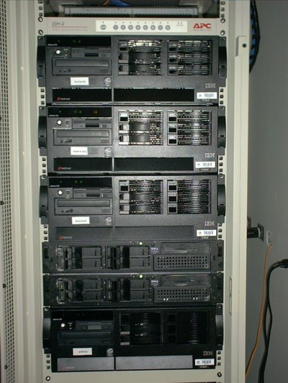
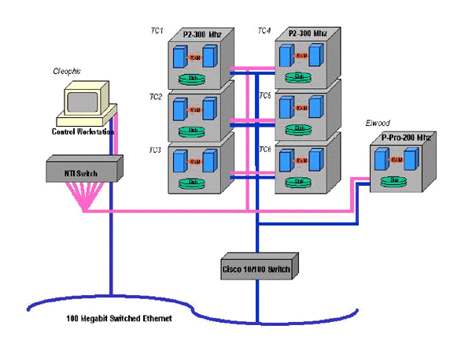
Mental Model

Slide 4
Principles of Message-Passing Programming
The logical view of a machine supporting the message-passing paradigm consists of p processes, each with its own exclusive address space.
Each data element must belong to one of the partitions of the space; hence, data must be explicitly partitioned and placed.
All interactions (read-only or read/write) require cooperation of two processes - the process that has the data and the process that wants to access the data.
These two constraints, while onerous, make underlying costs very explicit to the programmer.

Slide 5
Principles of Message-Passing Programming
Message-passing programs are often written using the asynchronous or loosely synchronous paradigms.
In the asynchronous paradigm, all concurrent tasks execute asynchronously.
In the loosely synchronous model, tasks or subsets of tasks synchronize to perform interactions. Between these interactions, tasks execute completely asynchronously.
Most message-passing programs are written using the single program multiple data (SPMD) model.

Slide 6
The Building Blocks: Send and Receive Operations
The prototypes of these operations are as follows:
send(void *sendbuf, int nelems, int dest)
receive(void *recvbuf, int nelems, int source)
Consider the following code segments:
P0 P1
a = 100; receive(&a, 1, 0)
send(&a, 1, 1); printf("%d\n", a);
a = 0;
The semantics of the send operation require that the value received by process P1 must be 100 as opposed to 0.
This motivates the design of the send and receive protocols.

Slide 7
Non-Buffered Blocking Message Passing Operations
A simple method for forcing send/receive semantics is for the send operation to return only when it is safe to do so.
In the non-buffered blocking send, the operation does not return until the matching receive has been encountered at the receiving process.
Idling and deadlocks are major issues with non-buffered blocking sends.
In buffered blocking sends, the sender simply copies the data into the designated buffer and returns after the copy operation has been completed. The data is copied into a buffer at the receiving end as well.
Buffering alleviates idling at the expense of copying overheads.

Slide 8
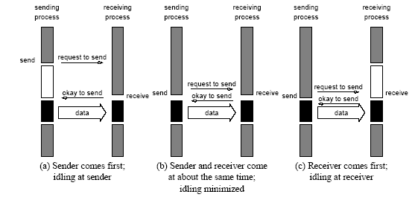
Non-Buffered Blocking Message Passing Operations
Handshake for a blocking non-buffered send/receive operation.
It is easy to see that in cases where sender and receiver do not
reach communication point at similar times, there can be considerable idling overheads.

Slide 9
Buffered Blocking Message Passing Operations
A simple solution to the idling and deadlocking problem outlined above is to rely on buffers at the sending and receiving ends.
The sender simply copies the data into the designated buffer and returns after the copy operation has been completed.
The data must be buffered at the receiving end as well.
Buffering trades off idling overhead for buffer copying overhead.

Slide 10
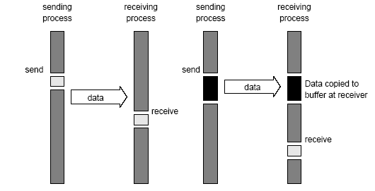
Buffered Blocking Message Passing Operations
Blocking buffered transfer protocols: (a) in the presence of
communication hardware with buffers at send and receive ends; and (b) in the absence of communication hardware, sender interrupts receiver and deposits data in buffer at receiver end.

Slide 11
Buffered Blocking Message Passing Operations
Bounded buffer sizes can have significant impact on performance.
P0 P1
for (i = 0; i < 1000; i++){ for (i = 0; i < 1000; i++){
produce_data(&a); receive(&a, 1, 0);
send(&a, 1, 1); consume_data(&a);
} }
What if consumer was much slower than producer?

Slide 12
Buffered Blocking Message Passing Operations
Deadlocks are still possible with buffering since receive operations block.
P0 P1
receive(&a, 1, 1); receive(&a, 1, 0);
send(&b, 1, 1); send(&b, 1, 0);

Slide 13
Non-Blocking Message Passing Operations
The programmer must ensure semantics of the send and receive.
This class of non-blocking protocols returns from the send or receive operation before it is semantically safe to do so.
Non-blocking operations are generally accompanied by a check-status operation.
When used correctly, these primitives are capable of overlapping communication overheads with useful computations.
Message passing libraries typically provide both blocking and non-blocking primitives.

Slide 14
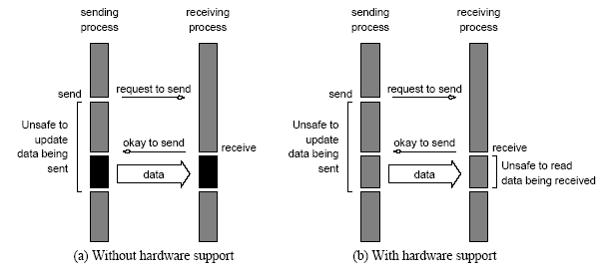
Non-Blocking Message Passing Operations
Non-blocking non-buffered send and receive operations (a) in
absence of communication hardware; (b) in presence of
communication hardware.

Slide 15
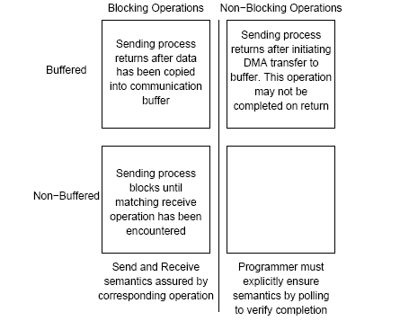
Send and Receive Protocols
Space of possible protocols for send and receive operations.

Slide 16
MPI: the Message Passing Interface
MPI defines a standard library for message-passing that can be used to develop portable message-passing programs using either C or Fortran.
The MPI standard defines both the syntax as well as the semantics of a core set of library routines.
Vendor implementations of MPI are available on almost all commercial parallel computers.
It is possible to write fully-functional message-passing programs by using only the six routines.
But it my not be all that efficient!!

Slide 17
MPI: the Message Passing Interface
The minimal set of MPI routines.
MPI_Init | Initializes MPI.
MPI_Finalize | Terminates MPI.
MPI_Comm_size | Determines the number of processes.
MPI_Comm_rank | Determines the label of calling process.
MPI_Send | Sends a “unbuffered/blocking” message.
MPI_Recv | Receives a “unbuffered/blocking message.

Slide 18
Starting and Terminating the MPI Library
MPI_Init is called prior to any calls to other MPI routines. Its purpose is to initialize the MPI environment.
MPI_Finalize is called at the end of the computation, and it performs various clean-up tasks to terminate the MPI environment.
The prototypes of these two functions are:
int MPI_Init(int *argc, char ***argv)
int MPI_Finalize()
MPI_Init also strips off any MPI related command-line arguments.
All MPI routines, data-types, and constants are prefixed by “MPI_”. The return code for successful completion is MPI_SUCCESS.

Slide 19
Communicators
A communicator defines a communication domain - a set of processes that are allowed to communicate with each other.
Information about communication domains is stored in variables of type MPI_Comm.
Communicators are used as arguments to all message transfer MPI routines.
A process can belong to many different (possibly overlapping) communication domains.
MPI defines a default communicator called MPI_COMM_WORLD which includes all the processes.

Slide 20
Querying Information
The MPI_Comm_size and MPI_Comm_rank functions are used to determine the number of processes and the label of the calling process, respectively.
The calling sequences of these routines are as follows:
int MPI_Comm_size(MPI_Comm comm, int *size)
int MPI_Comm_rank(MPI_Comm comm, int *rank)
The rank of a process is an integer that ranges from zero up to the size of the communicator minus one.

Slide 21
Our First MPI Program
// module load xl_r spectrum-mpi cuda/11.2
// compile with: mpicc mpi-hello.c –o mpi-hello
// run: mpirun –np #pes mpi-hello
#include<stdio.h>
#include <mpi.h>
main(int argc, char *argv[])
{
int npes, myrank;
MPI_Init(&argc, &argv);
MPI_Comm_size(MPI_COMM_WORLD, &npes);
MPI_Comm_rank(MPI_COMM_WORLD, &myrank);
printf("From process %d out of %d, Hello World!\n",
myrank, npes);
MPI_Finalize();
}
Let’s see how it works…

Slide 22
Sending and Receiving Messages
The basic functions for sending and receiving messages in MPI are the MPI_Send and MPI_Recv, respectively.
NOTE THESE FUNCTIONS CAN DEADLOCK
AVOID USING IN LARGE SCALE CODES!!
The calling sequences of these routines are as follows:
int MPI_Send(void *buf, int count, MPI_Datatype datatype, int dest, int tag,
MPI_Comm comm)
int MPI_Recv(void *buf, int count, MPI_Datatype datatype, int source, int tag, MPI_Comm comm, MPI_Status *status)
MPI provides equivalent datatypes for all C datatypes. This is done for portability reasons.
The datatype MPI_BYTE corresponds to a byte (8 bits) and MPI_PACKED corresponds to a collection of data items that has been created by packing non-contiguous data.
The message-tag can take values ranging from zero up to the MPI defined constant MPI_TAG_UB.

Slide 23
MPI Datatypes
MPI Datatype | C Datatype
MPI_CHAR | signed char
MPI_SHORT | signed short int
MPI_INT | signed int
MPI_LONG | signed long int
MPI_UNSIGNED_CHAR | unsigned char
MPI_UNSIGNED_SHORT | unsigned short int
MPI_UNSIGNED | unsigned int
MPI_UNSIGNED_LONG | unsigned long int
MPI_FLOAT | float
MPI_DOUBLE | double
MPI_LONG_DOUBLE | long double
MPI_BYTE
MPI_PACKED

Slide 24
Sending and Receiving Messages
MPI allows specification of wildcard arguments for both source and tag.
If source is set to MPI_ANY_SOURCE, then any process of the communication domain can be the source of the message.
If tag is set to MPI_ANY_TAG, then messages with any tag are accepted.
On the receive side, the message must be of length equal to or less than the length field specified.

Slide 25
Sending and Receiving Messages
On the receiving end, the status variable can be used to get information about the MPI_Recv operation.
The corresponding data structure contains:
typedef struct MPI_Status {
int MPI_SOURCE;
int MPI_TAG;
int MPI_ERROR; };
The MPI_Get_count function returns the precise count of data items received.
int MPI_Get_count(MPI_Status *status, MPI_Datatype datatype,
int *count)

Slide 26
Avoiding Deadlocks
Consider:
int a[10], b[10], myrank;
MPI_Status status;
...
MPI_Comm_rank(MPI_COMM_WORLD, &myrank);
if (myrank == 0) {
MPI_Send(a, 10, MPI_INT, 1, 1, MPI_COMM_WORLD);
MPI_Send(b, 10, MPI_INT, 1, 2, MPI_COMM_WORLD);
}
else if (myrank == 1) {
MPI_Recv(b, 10, MPI_INT, 0, 2, MPI_COMM_WORLD, &status);
MPI_Recv(a, 10, MPI_INT, 0, 1, MPI_COMM_WORLD, &status);
}
...
If MPI_Send is blocking, there is a deadlock!!

Slide 27
Avoiding Deadlocks
Consider the following piece of code, in which process i sends a message to process i + 1 (modulo the number of processes) and receives a message from process i - 1 (module the number of processes).
int a[10], b[10], npes, myrank;
MPI_Status status;
...
MPI_Comm_size(MPI_COMM_WORLD, &npes);
MPI_Comm_rank(MPI_COMM_WORLD, &myrank);
MPI_Send(a, 10, MPI_INT, (myrank+1)%npes, 1, MPI_COMM_WORLD);
MPI_Recv(b, 10, MPI_INT, (myrank-1+npes)%npes, 1, MPI_COMM_WORLD);
...
Once again, we have a deadlock if MPI_Send is blocking.

Slide 28
Avoiding Deadlocks
We can break the circular wait to avoid deadlocks as follows:
int a[10], b[10], npes, myrank;
MPI_Status status;
...
MPI_Comm_size(MPI_COMM_WORLD, &npes);
MPI_Comm_rank(MPI_COMM_WORLD, &myrank);
if (myrank%2 == 1) {
MPI_Send(a, 10, MPI_INT, (myrank+1)%npes, 1, MPI_COMM_WORLD);
MPI_Recv(b, 10, MPI_INT, (myrank-1+npes)%npes, 1, MPI_COMM_WORLD);
}
else {
MPI_Recv(b, 10, MPI_INT, (myrank-1+npes)%npes, 1, MPI_COMM_WORLD);
MPI_Send(a, 10, MPI_INT, (myrank+1)%npes, 1, MPI_COMM_WORLD);
}
...

Slide 29
Sending and Receiving Messages Simultaneously
To exchange messages, MPI provides the following function:
int MPI_Sendrecv(void *sendbuf, int sendcount,
MPI_Datatype senddatatype, int dest, int sendtag,
void *recvbuf, int recvcount, MPI_Datatype recvdatatype,
int source, int recvtag, MPI_Comm comm, MPI_Status *status)
The arguments include arguments to the send and receive
functions. If we wish to use the same buffer for both send and receive, we can use:
int MPI_Sendrecv_replace(void *buf, int count,
MPI_Datatype datatype, int dest, int sendtag,
int source, int recvtag, MPI_Comm comm,
MPI_Status *status)

Slide 30
Send/Recv Complex Data Types Across Heterogenous Sytems?
You might have wondered “Why do MPI send/recv routing require to know the MPI data type as well as the size?”
Seems like redundant information…
Size is only 1 piece of the data puzzle…
Byte order is the 2nd piece!! Big Endian vs. Little Endian!
Different machine architectures have different byte orders.

Slide 31
Byte Ordering
How should bytes within multi-byte word be ordered in memory?
Conventions
Older Mac’s are “Big Endian” machines
Least significant byte has highest address
Intel PC’s are “Little Endian” machines
Least significant byte has lowest address
Currently..
Bi-Endian hardware: ARM, PowerPC, DEC Alpha, SPARC V9, MIPS, PA-RISC, and IA64
Note: terms comes from Gulliver’s Travels which denotes which end of the soft boiled egg you should crack .. Big or little “endian”…

Slide 32
Byte Ordering Example
Big Endian
Least significant byte has highest address
Little Endian
Least significant byte has lowest address
Example
Variable x has 4-byte representation 0x01234567
Address given by &x is 0x100
Big Endian
0x100
0x101
0x102
0x103
01
01
23
23
45
45
67
67
Little Endian
0x100
0x101
0x102
0x103
67
67
45
45
23
23
01
01
Ouch!.. what a pain for message passing programs!!

Slide 33
Pack/Unpack MPI Semantics Solves “Endian” problems
#include <mpi.h>
{
unsigned int membersize, maxsize;
int position;
int dest, tag;
char *buffer;
/* * Do this once. */
MPI_Pack_size(1, /* one element */
MPI_INT, /* datatype integer */
MPI_COMM_WORLD, /* consistent comm. */
&membersize); /* max packing space req'd */
maxsize = membersize;
MPI_Pack_size(1024, MPI_CHAR, MPI_COMM_WORLD, &membersize); maxsize += membersize;
buffer = malloc(maxsize);
/* * Do this for every new message. */
position = 0;
MPI_Pack(&scanline.lineno, /* pack this element */
1, /* one element */
MPI_INT, /* datatype int */
buffer, /* packing buffer */
maxsize, /* buffer size */
&position, /* next free byte offset */
MPI_COMM_WORLD); /* consistent comm. */
MPI_Pack(scanline.pixels, 1024, MPI_CHAR, buffer, maxsize, &position, MPI_COMM_WORLD);
MPI_Send(buffer, position, MPI_PACKED, dest, tag, MPI_COMM_WORLD);
}

Slide 34
Recv side MPI Unpack…
{
int src;
int msgsize;
MPI_Status status;
MPI_Recv(buffer, maxsize, MPI_PACKED, src, tag, MPI_COMM_WORLD, &status);
position = 0;
MPI_Get_count(&status, MPI_PACKED, &msgsize);
MPI_Unpack(buffer, /* packing buffer */
msgsize, /* buffer size */
&position, /* next element byte offset */ &scanline.lineno, /* unpack this element */
1, /* one element */
MPI_INT, /* datatype int */
MPI_COMM_WORLD); /* consistent comm. */
MPI_Unpack(buffer, msgsize, &position, scanline.pixels, 1024, MPI_CHAR, MPI_COMM_WORLD);
}

Slide 35
Summary
Parallel Programming Mental Model
Think of a network of workstations (NOWs)
Applications explicitly send messages and recv messages between processors/workstations.
MPI provides a clean API for sending and receiving messages between computer systems that provides the illusion of larger, integrate parallel computer.
Blocking send/recv
Buffered send/recv
Simultaneous send/recv
Define new types
Marshall whole complex data structures across hetergeneous systems..

